Slide 1
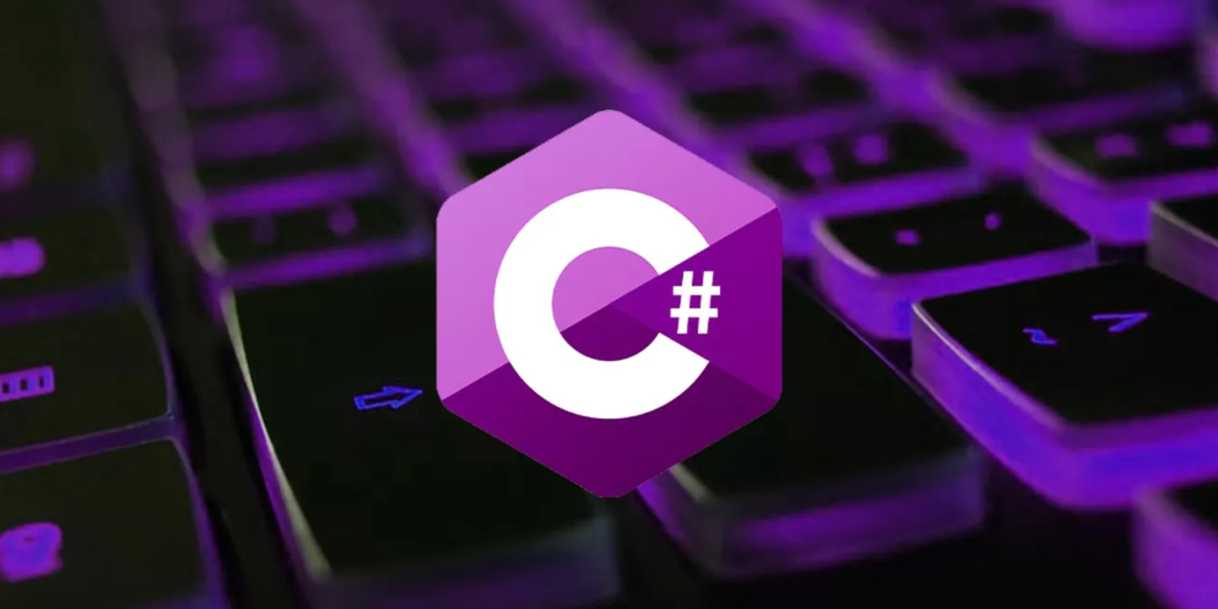

Slide 2

Development:
1998-2001
Company:
Microsoft
Author:
Anders Heilsberg

Slide 3
Basic principles of OOP
Encapsulation
Inheritance
Polymorphism

Slide 4
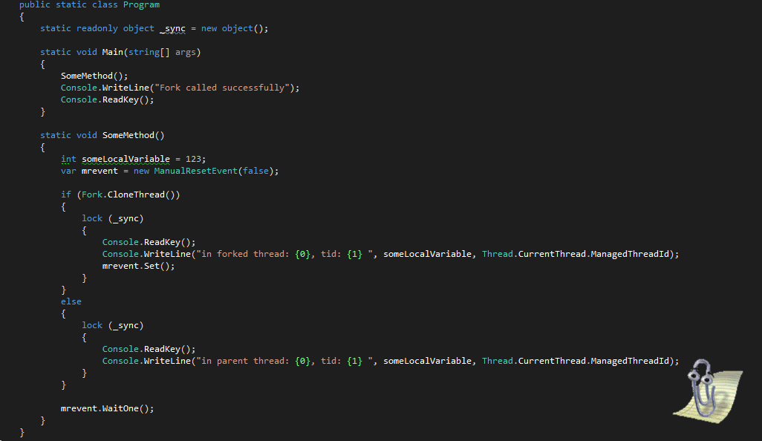

Slide 5
Advantages
Disadvantages
a large community
a large number of libraries and templates
strong typing
convenient tools (automatic garbage collection, events, methods)
powerful OOP support
universal and flexible language
priority focus on the Windows platform
some security problems
Sometimes the behavior of a program can be unexpected

Slide 6
using C# we can create:
web services
Games
apps for Android and iOS
programs for Windows

Slide 7
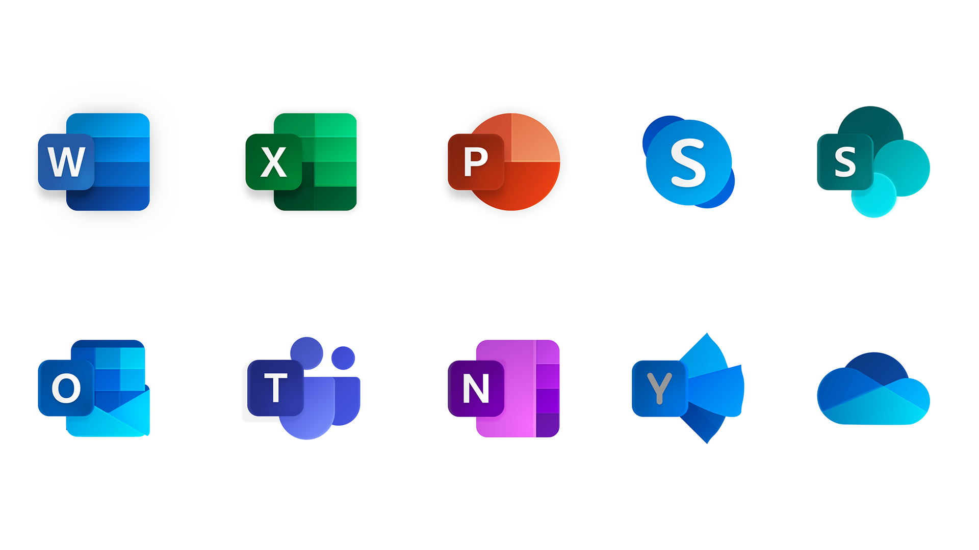

Slide 8







Slide 9
questions
When did the development of the C# language begin?
What company created this language?
Who led the development team?
What applications were created using C#?
What principles of OOP does C# support?

